Slide 2
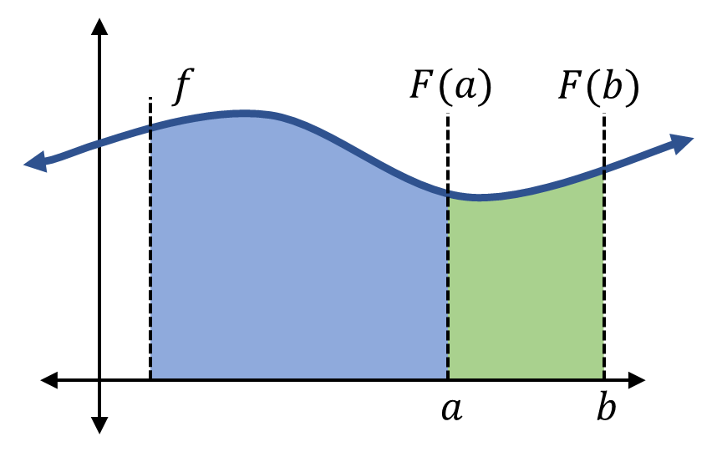

Slide 3





$$f$$
$$F(a)$$
$$F(b)$$
$$a$$
$$b$$

Slide 4
Definite Integral
Means a number.
Has a definite interval.
Indefinite Integral
Means one or more function(s).
Works accross the domain.
Both
Use the antiderivative.
Signify area under the curve.

